Slide 1

Notes:
How did you like the sessions so far?
Today we will do some real work with Python

Slide 2
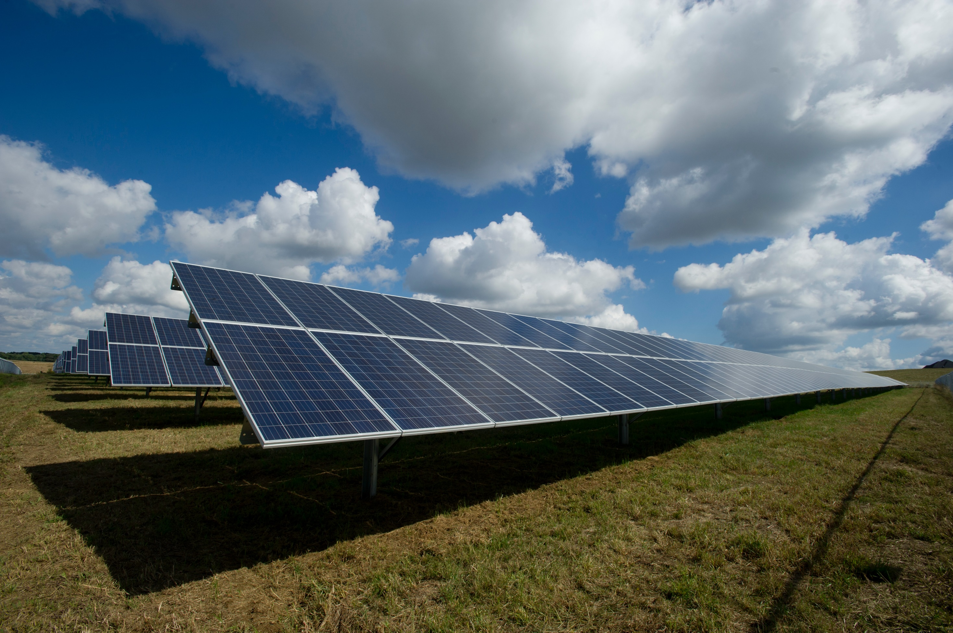
Notes:
We will look at data from Moxa solar panel
Obviously weather conditions and the sun is very relevant

Slide 3

Notes:
Workshop means WORK
You have to work
We will try to give some tips on what is important in a work-environment

Slide 4
Session 2019-11-20

Slide 5
Work with the raw IoT data in Azure
git clone https://github.com/martido/redi.git
cd class-2019
Follow instructions in README to set up conda environment
jupyter notebook
Open session_2019-11-20/azure_iot_data_processing_template.ipynb
Task 1
Download IoT data from Azure Blob Storage.
Parse the data and load it into a Pandas DataFrame.x

Slide 6
Session 2019-12-04

Slide 7
Work with the preprocessed data
All relevant files are stored in “class-2019/data/solar-panel-csv”.
There are a lot of them, all CSVs; the separator is “|”.
The data was preprocessed on the edge device and contains both the solar panel telemetry data as well as weather data.
Task 2
Load the data into one Pandas DataFrame.
What is there? How is the quality?
What might be important, what not?

Slide 8
Understanding the data
What are the (two) most important attributes in the data?
Date and Time
Why? It identifies the measurements. It can be used to join data.
What is important besides time? Location. Is not in the data. Only Moxa Office.
What is also relevant besides absolute date/time?
Frequency
Which frequency has the data? Do all attributes have the same frequency?
What is the second most important attribute?
The one we want to predict / optimize. → Power!
What might influence power from the solar panel?
What would be a business application?
Choose best place for your solar plant.
Here: Understand the influence factors.

Slide 9
Clean and improve the data
Look more closely at the data.
Later, we would like to analyze the data and understand which variables affect power.
Task 3
Identify and list potential problems with the data set as it is now.
Fix / improve at least one problem.

Slide 10
Problems in the data
Missing attributes
Wind and feels like temperature (not important)
Elevation and Azimuth (important)
Gaps in the measurements
Not every minute has a measurement
Potentially relevant, depends on questions asked, difficult to fix
Limited time frame, seasons not covered
Impossible to fix
DateTime Index would be very helpful
We will do it together, makes plotting easier
Strange values
E.g. temperature values from sensor, easy to fix (example)
N/A values
Not there. Good, because some algorithms do not work if data has N/A values

Slide 11
A DateTime index is useful
df['DateTime'] = pd.to_datetime(df['Date'] + ' ' + df['Time'])
df.set_index(["DateTime"], inplace=True)
df.drop(columns=["Date", "Time"], inplace=True)
Working with the index:
df.loc["2019-08-10 05:00":"2019-08-10 09:00"]
df.loc["2019-08-10"]
df.loc["2019-08-10":"2019-08-12"]

Slide 12

Notes:
Pandas is a big help

Slide 13
Session 2020-01-08

Slide 14
Visualize the data
Looking at diagrams helps a lot with understanding your data.
matplotlib gives you a lot of options. It’s easy to use with Pandas.
But, without further work, it tends to look somewhat ugly.
Task 4
Try to understand the data better by visualizing selected attributes.
Remember that we are dealing with time-based data.
The sun has a daily cycle, might be worth investigating.

Slide 15

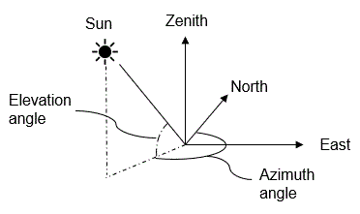
Azimuth and Elevation
How is it supposed to look like?
How does it look in the data?

Slide 16
Join an additional data set
Use the data on Azimuth and Elevation in “class-2019/data”.
Task 5
Load the data into Pandas dataframes. Does it look plausible?
Transform the data as needed and join it to our existing data.

